Slide 1
Breast Cancer Detection By Using Machine Learning

Slide 2
Team Members :
Chereddy Sri Lakshmi (700740115)
Mallula Gowtham

Slide 3
Responsibilities:
Chereddy Sri Lakshmi :
Worked on Dataset, Data preprocessing, Decision Tree, Random Forest & Documentation.
Mallula Gowtham :
Worked on Dataset, Data visualization, SVM, Ada boost algorithm & Documentation

Slide 4
Motivation :
Breast cancer is one of the most common cancer in women and the second leading cause of women’s cancer death
Despite the lack of effective treatment, the low accuracy of diagnosis is also a major cause of the high incidence and mortality of breast cancer. Mammography is a traditional method used for diagnosing breast cancer.
According to UC Health's report, only 78% of breast cancer can be accurately diagnosed by mammography

Slide 5
Objectives :
Cleaning data by deleting the rows missing values or null values to prepare the data effectively to train the machine learning model
To implement and evaluate the classification models available in machine learning for the considered breast cancer dataset.
Machine Learning Algorithms that we are trained for the breast cancer dataset are :
        Logistic Regression
        Support Vector Machine
        K - Nearest neighbors
        Naive Bayes
        Random Forest

Slide 6
Related Work :
Earlier, research regarding the classification and prediction of breast cancer has been carried out using several data mining techniques. Classification and agglomeration are 2 widely used ways in information mining
Furthermore, essential progress has been carried out when it comes to breast cancer survivability prediction using labeled, unlabeled, and pseudo-labeled patient data.
Neural networks and related techniques have a vast contribution when it comes to predicting breast cancer.
ANNs have afforded numerous successes with great progress in Breast Cancer classification and diagnosis in the very early stages
A typical ANN model is made up of a hierarchy of layers: input, hidden, and output layers.

Slide 7
Problem Statement :
Breast cancer is one of the most dreaded and com- monly occurring malignancies currently among women, affecting around 10% of women worldwide at different stages of their lives . The biggest problem arises when the disease cannot be accurately diagnosed at the very early stages, despite the fact that the treatment for this illness is now accessible in practice in many countries.
In this area, machine learning has proven to be essential in predicting illnesses like cancer.

Slide 8
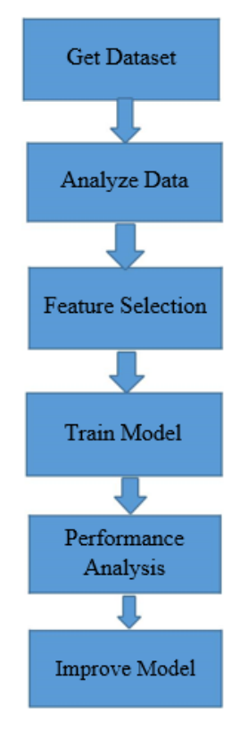
Proposed Solution :
We have outlined a simple model to come with the most accurate predictions.
The first objective was to attain a dataset of numerical values of various instances.
Upon finalizing our dataset, we split the train-test ration to 70:30 in order to train and test six algorithms: Random forest, K-Neighbors, Logistic Regression, Naive Bayes and Support Vector machine (SVM).
Feature selection in the form of Principal Component Analysis is used to reduce dimensionality of the dataset.
The models are trained again by means of training and testing and finally compared the results with that of the previous results.

Slide 9
Results :
The next step after applying implementing machine learning models is to seek out how effective is that the model, i.e. how the models performed on the datasets.
This is carried out by running the models on the test dataset which was set earlier.
The test dataset comprised of 30% of the dataset for Breast Cancer prediction.
We evaluated six machine learning algorithms, they are logistic regression, random forest classifier, KNN classifier, Naive Bayes classifier, and Support vector machine.

Slide 10
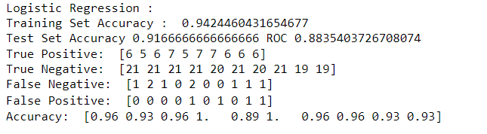
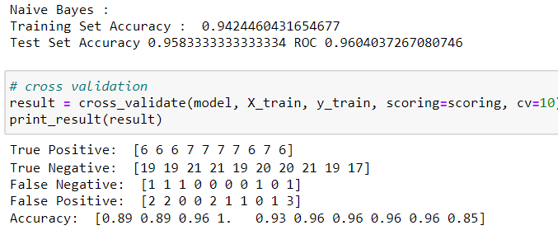

Slide 11
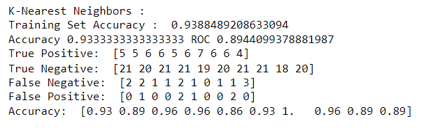
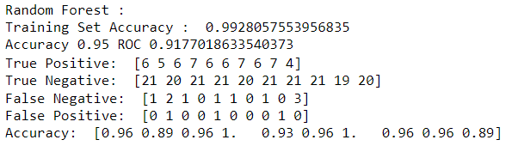
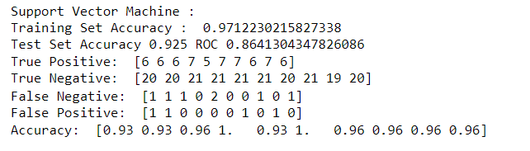

Slide 12
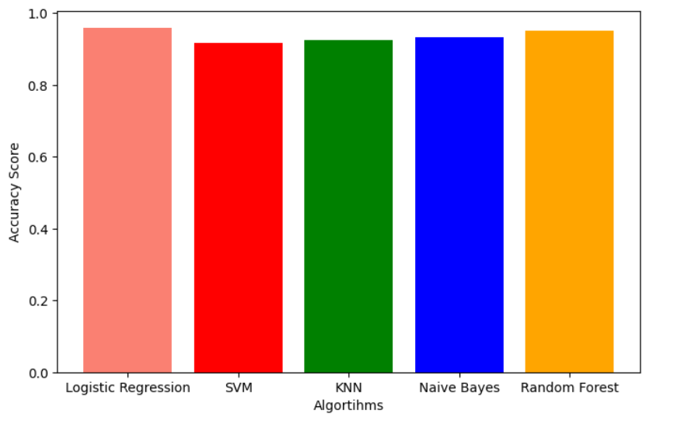
Accuracy Graph
For Classifiers

Slide 13
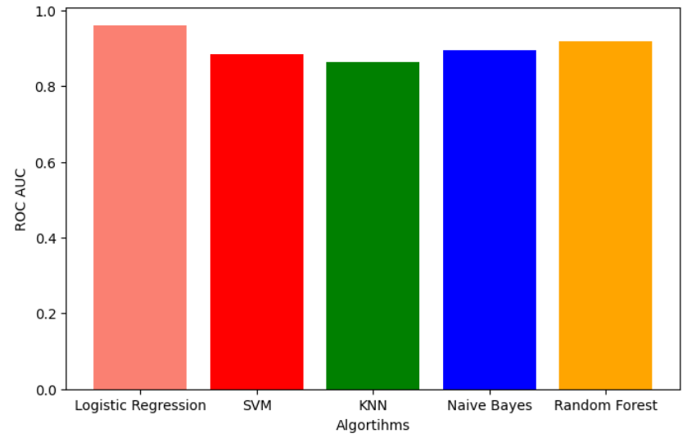
ROC Curves for different classifiers

Slide 14
Conclusion :
In terms of accuracy, Naive Bayes, has scored 0.964. K- Neighbors (0.9349) and Logistic regression (0.923) are not far behind either. SVM scores 0.917 in accuracy. Decision Tree performs the worst among all six resulting 0.834.
Considering the other performance matrix into account, a lot can be determined regarding the performance of the algorithms.
K- Neighbors and Naive Bayes performs better SVM and Logistic Regression scores a perfect 1.000 when it comes to recall, which is vital in terms of disease prediction, even though there are declines in the values of all other performance metrics of both the mentioned algorithms.
keeping the recall score into consideration, we can conclude that Logistic Regression and Support Vector Analysis performs better

Slide 15
References :
Breast cancer facts and figures 2003-2004 (2003). American Cancer Society
[2] Stages — Mesothelioma — Cancer Research UK Breast cancer survival statistics September 26, 2017
[3] PendharkarPC,RodgerJA,YaverbaumGJ,HermanN,BennerM(1999) Association, statistical, mathematical and neural approaches for mining breast cancer patterns. Expert Systems with Applications 17: 223-232.
[4] deepsense.ai What is reinforcement learning? The complete guide July 05, 2018
[5] Hacker Noon Absolute Fundamentals of Machine Learning – Hacker Noon January 15, 2018
[6] Furundzic, D.; Djordjevic, M.; Bekic, A.J. Neural networks approach to early breast cancer detection. J. Syst. Archit. 1998, 44, 617–633. [CrossRef]
[7] ] Floyd, C.E.; Lo, J.Y.; Yun, A.J.; Sullivan, D.C.; Kornguth, P.J. Prediction of breast cancer malignancy using an artificial neural network. Cancer 1994, 74, 2944–2948. [CrossRef]
[8] H. A. Abbass, “An evolutionary artificial neural networks approach fo
[9] J. Khan, J. S. Wei, M. Ringne ́r, L. H. Saal, M. Ladanyi, F. Westermann, F. Berthold, M. Schwab, C. R. Antonescu, C. Peterson, and P. S. Meltzer, “Classification and diagnostic prediction of cancers using gene expression profiling and artificial neural networks.,” Nat. Med., vol. 7,
no. 6, pp. 673–9, Jun. 2001.
[10] G.-B. Huang, Q.-Y. Zhu, and C.-K. Siew, “Extreme learning machine:
Theory and applications,” Neurocomputing, (Dec. 2006.) vol. 70, no.
1–3, pp. 489–501.

Slide 16
C. P. Utomo, A. Kardiana, and R. Yuliwulandari, “Breast Cancer
Diagnosis using Artifi-cial Neural Networks with Extreme Learning
Techniques,” Int. J. Adv. Res. Artif. Intell, vol. 3, no. 7,pp. 10–14,
[12] Fine Needle Aspiration Biopsy of the Breast. American Cancer Society.
[13] Friedman, Jerome, Trevor Hastie, and Rob Tibshirani. Regularization
paths for generalized linear models via coordinate descent.” Journal of statistical software 33.1 (2010): 1
[14] Rohith Gandhi. Nearest Neighbor. Understanding Machine Learning (2018)
[15] MachineLearningMasteryDiscriminantAnalysisforMachineLearning September 22, (2016)
[16] G.-B. Huang, Q.-Y. Zhu, and C.-K. Siew, “Extreme learning machine: Theory and applications,” Neurocomputing, (Dec. 2006.) vol. 70, no. 1–3, pp. 489–501.
[17] C. P. Utomo, A. Kardiana, and R. Yuliwulandari, “Breast Cancer Diagnosis using Artifi-cial Neural Networks with Extreme Learning Techniques,” Int. J. Adv. Res. Artif. Intell, vol. 3, no. 7, pp. 10–14
[18] William H Wolberg, W Nick Street, and Olvi L Mangasarian. (1992). Breast cancer Wisconsin (diagnostic) data set. UCI Machine Learning Repository.
[19] H. A. Abbass, “An evolutionary artificial neural networks approach for breast cancer diagnosis.” Artif.Intell. Med., vol. 25, no. 3, pp. 265–81,
[20] J. Khan, J. S. Wei, M. Ringne ́r, L. H. Saal, M. Ladanyi, F. Westermann,
F. Berthold, M. Schwab, C. R. Antonescu, C. Peterson, and P. S. Meltzer, “Classification and diagnostic prediction of cancers using gene expression profiling and artificial neural networks.,” Nat. Med., vol. 7, no. 6, pp. 673–9

